Slide 1
Bayesian Theorem

Slide 2

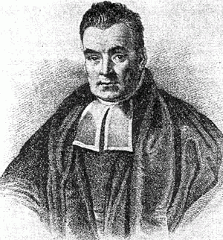
Having a strong opinion about an issue can make it hard to take in new information about it, or to consider other options when they're presented.
Thomas Bayes

Slide 3

Example
A patient goes to see a doctor. The doctor performs a test with 99% reliability—that is,
99% of people who are sick test positive and
99% of the healthy people test negative.
The doctor knows that only 1% of the people in the country are sick.
Now: if the patient tests positive, what are the chances the patient is sick?

Slide 4
Example cont..
The intuitive answer is 99 %, but the correct answer is 50 %.
Bayes's theorem gives us the relationship between what we know and what we want to know.
In this problem what we are given--what we know--is p(+|s), which a mathematician would read as "the probability of testing positive given that you are sick";
what we want to know is p(s|+), or "the probability of being sick given that you tested positive.

Slide 5
Example cont..
Imagine that the above story takes place in a small country, with 10,000 people.
From the prior p(s)=0.01, we know that 1 %, or 100 people, are sick, and 9,900 are healthy.
If we administer the test to everyone, the most probable result is that 99 of the 100 sick people test positive.
Since the test has a 1 % error rate, however, it is also probable that 99 of the healthy people test positive.
Now if the doctor sends everyone who tests positive to the national hospital, there will be an equal number of healthy and sick patients.
If you meet one, even though you are armed with the information that the patient tested positive, there is only a 50 % chance this person is sick.

Slide 6
Now imagine the doctor moves to another country, performing the same test, with the same likelihood (p(+|s)) and, for that matter, the same success rate for healthy people, which we might call p(-|h), "the probability of scoring negative given that one is healthy."
In this country, however, we suppose that only one in every 200 people is sick.
If a new patient tests positive, it is actually more probable that the patient is healthy than sick. The doctor needs to update the prior.

Slide 7
Probability and Statistics
Probability is starting with an animal, and figuring out what footprints it will make.
Statistics is seeing a footprint, and guessing the animal.
Statistics is harder.
We measure the footprints and have to guess what animal it could be. A bear? A human? If we get 6 heads and 4 tails, what're the chances of a fair coin?

Slide 8
What is Probability
A Graphical Intuition for Definition of Probability

Slide 9
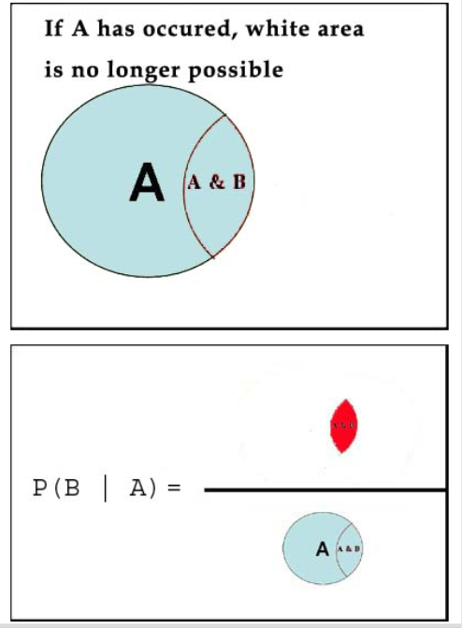
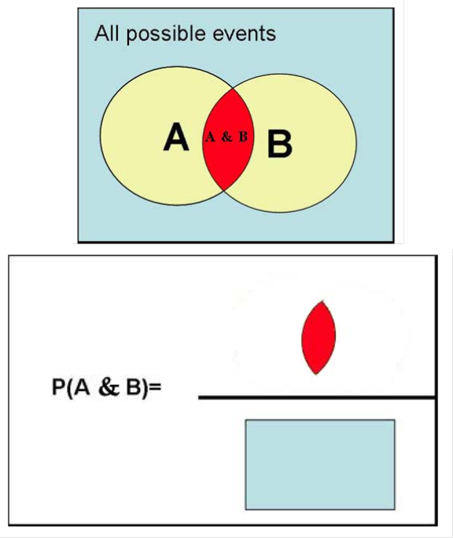
Probability
Probability A or B
Probability of B Given A is Calculated by Reducing Possibilities
Probability A and B

Slide 10
Deriving Bayes' Theorem

Slide 11
Bayes Rule
While this is an equation that applies to any probability distribution over events and , it has a particularly nice interpretation in the case where A represents H a hypothesis and B represents E some observed evidence . In this case, the formula can be written as
likehood function
Posterior probability
prior probability
This relates the probability of the hypothesis before getting the evidence
to the probability of the hypothesis after getting the evidence,
For this reason, is called the prior probability,
while
is called the posterior probability
The factor that relates the two
is called the likelihood ratio.

Slide 12
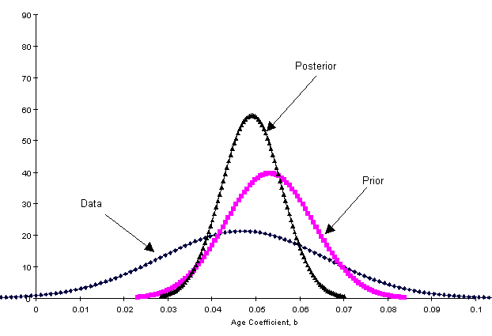

Slide 13
Paradoxical Problem
1. A couple has two children and the older child is a boy. If the probabilities of having a boy or a girl are both , what is the probability that the couple has two boys?
We already know that the older child is a boy. The probability of two boys is equivalent to the probability that the younger child is a boy, which is .
2. A couple has two children, one of which is a boy. If the probabilities of having a boy or a girl are both , what is the probability that the couple has two boys?
At first glance, this appears to be asking the same question. We might reason as follows: “We know that one is a boy, so the only question is whether the other one is a boy, and the chances of that being the case are . So again, the answer is .”
This makes perfect sense. It also happens to be incorrect.

Slide 14
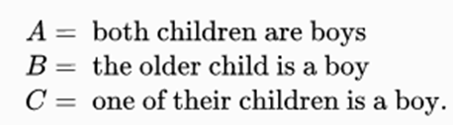
Paradoxical Problem cont..
The first is computed using the simpler version of Bayes’ theorem:

Slide 15
Riddle
A man wakes up in the middle of the night with a splitting headache. He remembers that there are few aspirin bottles in the bathroom. He dizzily stumbles into his bathroom to grab one of the four bottles in the dark and pops a pill from that bottle. An hour later, instead of getting relief from headache, he starts feeling a terrible nausea. Suddenly he realizes that only three of the four bottles in the bathroom contained aspirin and the fourth bottle contained poison.
The tragedy of the situation was that, like poison, aspirin also causes nausea sometimes. The label on the poison bottle said that 75 %t people who take the poison will show the nausea symptoms. Whereas the sticker on the aspirin bottle read that only 10 % would feel the same symptoms after taking aspirin.
What are the chances that the man took poison pill instead of aspirin?
This question is different from – what’s the probability that man took poison before he started getting nausea? because here we have an additional piece of information i.e., the man is experiencing nausea.

Slide 16
Problem Analysis
So let’s extend the problem and assume that there were 400 men going through the same ordeal at the same time on the same fateful night.
Step 1
Since there were 4 bottles in each case, 1 in 4 men is likely to pick up the poison bottle and 3 in 4 men are likely to pick up the aspirin bottle.
Number of men who took the poison pill = 100
Number of men who took the aspirin = 300
Step 2
Based on the information provided by medical text on the bottle labels, we can say –
Number of men who took the poison pill and showed the symptoms = 0.75 X 100 = 75 (75% according to the medical text)
Number of men who took the aspirin and showed the symptoms = 0.10 X 300 = 30 (10% according to the medical text)
Step 3
Total number of men who showed the symptoms = 75 + 30 = 105
Number of men with symptom who actually took the poison pill = 75
Step 4
So the probability of a man taking the poison pill, given that he showed symptoms = 75/105 = 0.71 (71 %)

Slide 17
Example II
A taxi was involved in a hit-and-run accident at night. Two taxi companies, the Green and the Blue, operate in the city. You are given the following data
85% of the taxis in the city are Green and 15% are Blue.
A witness identified the taxi as Blue. The court tested the reliability of the witness under the circumstances that existed on the night of the accident and concluded that the witness correctly identified each one of the two colors 80% of the time and failed 20% of the time.
What is the probability that the taxi involved in the accident was Blue?
If this was a courtroom scene in a Bollywood movie the drama would probably revolve around the argument about witness’s honesty.
But for a Bayesian thinker, the answer will be based on a probabilistic outcome.
Let’s use Bayes rule here.

Slide 18
Example II Analysis
P(A) = The probability of a taxi being Blue = 0.15
P(B/A) = The probability that it was a blue taxi and the witness identified it correctly = (0.15 X 0.8) = 0.12
P(B) = The probability of witness identifying it as a blue taxi
= Probability of witness identifying a blue taxi correctly + Probability of witness identifying a green taxi incorrectly.
= 0.15 X 0.8 + 0.85 X 0.2 = 0.29
P(A/B) = The probability of a taxi being Blue given that it was involved in the hit and run.
Plugging the values in the Bayes formula we get
P(A/B) = 0.15 X 0.12 / 0.29 = 0.41
Therefore, the confidence level of jury (for blue taxi being the culprit) should be only 41% !!

Slide 19
Base Rate and Like hood Ratio
Two important ideas on which Bayes theorem rests.
First is the base rate (or prior odds) and the second is likelihood ratio (strength of the new evidence).
In our taxi example, the base rate is the relative population of taxis. In other words, in the absence of witness, the probability of the guilty taxi being Blue (15 %) is the base rate of that outcome.
Similarly, in the ‘man with a poison pill’ example, the base rate was 25 %t (because there were four bottles out of which one was poison).
The base rates typically come from historical statistical information.
The eye witness’s reliability to identify the taxi correctly (80 %) is the likelihood ratio. The likelihood ratio represents new information about a specific case which changes the base rate for that particular case.
Posterior odds (Conditional Probability) = Prior odds (Base Rate) × Likelihood ratio

Slide 20
Example II cont…
Imagine that a new eyewitness comes out in the taxi case and holds the same opinion as the first witness. In his case he’s able to correctly identify each one of the two colors 70% of the time and failed 30% of the time.
With this new evidence (the new likelihood ratio is 0.7), the probability of involved taxi being blue will change again. By how much?
Use Bayes rule but this time the base rate will not be 15 %. Now you need to use the new base rate which is 41 %, calculated as the posterior odds previously. So the new probability (the new posterior odds) will now become (using the same Bayes formula) 61 %.

Slide 21
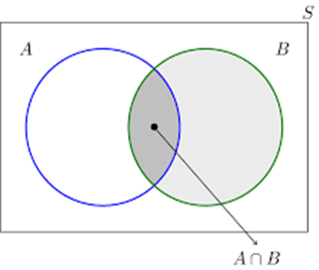
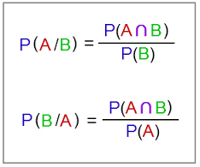
Conditional Probability
A math teacher gave her class two tests. 25% of the class passed both tests and 42% of the class passed the first test. What per cent of those who passed the first test also passed the second test?
Event A – Test1 Pass Student
Event B – Test2 Pass Student
25%
P(A) =42 %
42%
P(A and B) = 25 %
P(B|A) = ?
P(B|A) = 25/42 = 0.6

Slide 22
Conditional Probability
At Central School, the probability that a student takes Technology and French is 0.087. The probability that a student takes Technology is 0.68. What is the probability that a student takes French given that the student is taking Technology?
P(French and Technology)
P(French | Technology)
=
-------------------------------------------
P(Technology)
0.087
=
----------------------
0.68
=
0.13
=
13 %

Slide 23
Bayes Theorem
Named after its inventor, the 18th-century Presbyterian minister Thomas Bayes.
Bayes’ theorem is a method for calculating the validity of beliefs (hypotheses, claims, propositions) based on the best available evidence (observations, data, information).
Here’s the most dumbed-down description
Initial belief plus new evidence = new and improved belief.

Slide 24
Mammogram Tests
Tests are not the event. We have a cancer test, separate from the event of actually having cancer. We have a test for spam, separate from the event of actually having a spam message.
Tests are flawed. Tests detect things that don’t exist (false positive), and miss things that do exist (false negative).
Tests give us test probabilities, not the real probabilities. People often consider the test results directly, without considering the errors in the tests.
False positives skew results. Suppose you are searching for something really rare (1 in a million). Even with a good test, it’s likely that a positive result is really a false positive on somebody in the 999,999.
People prefer natural numbers. Saying “100 in 10,000″ rather than “1%” helps people work through the numbers with fewer errors, especially with multiple percentages (“Of those 100, 80 will test positive” rather than “80% of the 1% will test positive”).
Even science is a test. At a philosophical level, scientific experiments can be considered “potentially flawed tests” and need to be treated accordingly. There is a test for a chemical, or a phenomenon, and there is the event of the phenomenon itself. Our tests and measuring equipment have some inherent rate of error.

Slide 25
Mammogram Tests …cont..
Bayes’ theorem converts the results from your test into the real probability of the event. For example, you can:
Correct for measurement errors. If you know the real probabilities and the chance of a false positive and false negative, you can correct for measurement errors.
Relate the actual probability to the measured test probability. Bayes’ theorem lets you relate Pr(A|X), the chance that an event A happened given the indicator X, and Pr(X|A), the chance the indicator X happened given that event A occurred. Given mammogram test results and known error rates, you can predict the actual chance of having cancer.

Slide 26
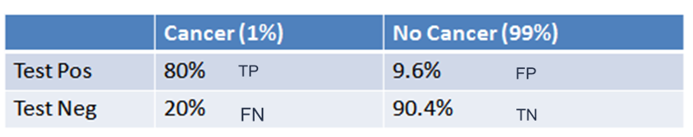
Anatomy of a Test
1% of women have breast cancer (and therefore 99% do not).
80% of mammograms detect breast cancer when it is there (and therefore 20% miss it).
9.6% of mammograms detect breast cancer when it’s not there (and therefore 90.4% correctly return a negative result).
1% of people have cancer
If you already have cancer, you are in the first column. There’s an 80% chance you will test positive. There’s a 20% chance you will test negative.
If you don’t have cancer, you are in the second column. There’s a 9.6% chance you will test positive, and a 90.4% chance you will test negative.

Slide 27

How Accurate Is The Test?
Now suppose you get a positive test result.
What are the chances you have cancer ? 80%? 99%? 1%?
Ok, we got a positive result. It means we’re somewhere in the top row of our table.
Let’s not assume anything — it could be a true positive or a false positive.
The chances of a true positive = chance you have cancer * chance test caught it = 1% * 80% = .008
The chances of a false positive = chance you don’t have cancer * chance test caught it anyway = 99% * 9.6% = 0.09504

Slide 28
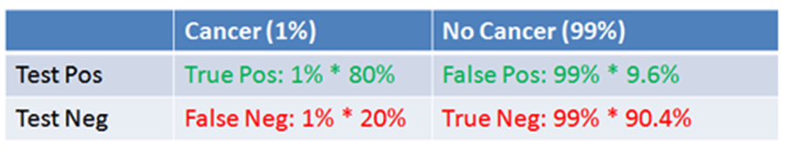
How Accurate Is The Test?
What’s the chance we really have cancer if we get a positive result ????.
The chance of an event is the number of ways it could happen given all possible outcomes
The chance of getting a real, positive result is .008.
The chance of getting any type of positive result is the chance of a true positive plus the chance of a false positive (.008 + 0.09504 = .10304).
So, our chance of cancer is .008/.10304 = 0.0776, or about 7.8%.
Interesting — a positive mammogram only means you have a 7.8% chance of cancer, rather than 80% (the supposed accuracy of the test). It might seem strange at first but it makes sense: the test gives a false positive 9.6% of the time, so there will be a ton of false positives in any given population. There will be so many false positives, in fact, that most of the positive test results will be wrong.

Slide 29
Bayes’ Theorem
We can turn the process above into an equation, which is Bayes’ Theorem. It lets you take the test results and correct for the “skew” introduced by false positives. You get the real chance of having the event. Here’s the equation:
And here’s the decoder key to read it:
Pr(A|X) = Chance of having cancer (A) given a positive test (X). This is what we want to know: How likely is it to have cancer with a positive result? In our case it was 7.8%.
Pr(X|A) = Chance of a positive test (X) given that you had cancer (A). This is the chance of a true positive, 80% in our case.
Pr(A) = Chance of having cancer (1%).
Pr(not A) = Chance of not having cancer (99%).
Pr(X|not A) = Chance of a positive test (X) given that you didn’t have cancer (~A). This is a false positive, 9.6% in our case.

Slide 30
It all comes down to the chance of a true positive result divided by the chance of any positive result. We can simplify the equation to:
Pr(X) is a normalizing constant and helps scale our equation. Without it, we might think that a positive test result gives us an 80% chance of having cancer.
Pr(X) tells us the chance of getting any positive result, whether it’s a real positive in the cancer population (1%) or a false positive in the non-cancer population (99%). It’s a bit like a weighted average, and helps us compare against the overall chance of a positive result.
In our case, Pr(X) gets really large because of the potential for false positives. Thank you, normalizing constant, for setting us straight! This is the part many of us may neglect, which makes the result of 7.8% counter-intuitive.

Slide 31
Bayesian Spam Filtering
One clever application of Bayes’ Theorem is in spam filtering. We have
Event A: The message is spam.
Test X: The message contains certain words (X)
Plugged into a more readable formula (from Wikipedia):
Bayesian filtering allows us to predict the chance a message is really spam given the “test results” (the presence of certain words). Clearly, words like “viagra” have a higher chance of appearing in spam messages than in normal ones.
Spam filtering based on a blacklist is flawed — it’s too restrictive and false positives are too great. But Bayesian filtering gives us a middle ground — we use probabilities. As we analyze the words in a message, we can compute the chance it is spam (rather than making a yes/no decision). If a message has a 99.9% chance of being spam, it probably is. As the filter gets trained with more and more messages, it updates the probabilities that certain words lead to spam messages. Advanced Bayesian filters can examine multiple words in a row, as another data point.

